Slide 1
Section 1b: Finding the AIF/VOF

Slide 2
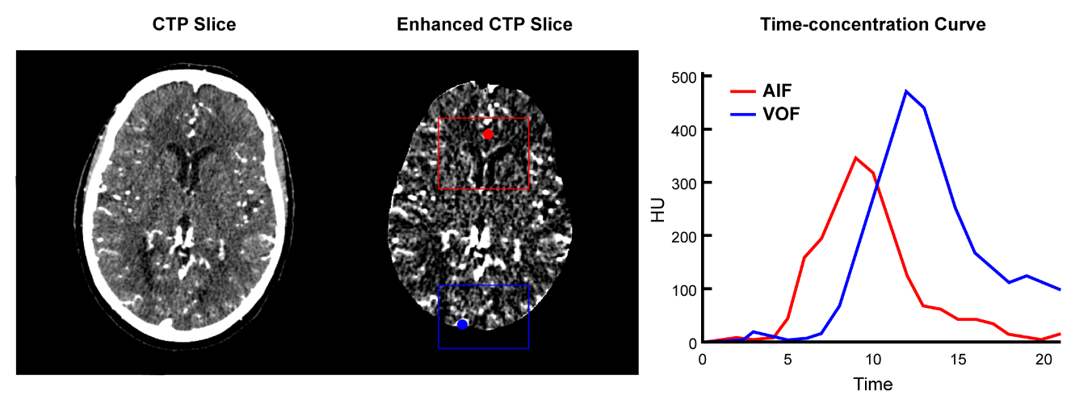
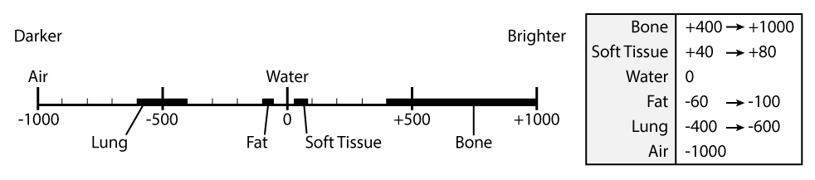
An example of the AIF/VOF curve using automatic selection and the scale that the CT image uses.

Slide 3
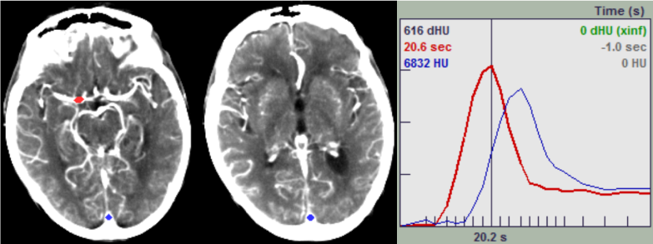
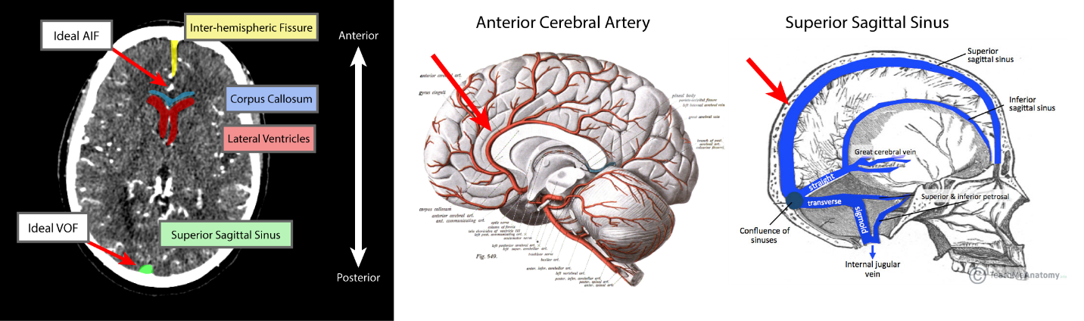
Examples of how to anatomically find the AIF/VOF.

Slide 4
Section 1c: Setup

Slide 5
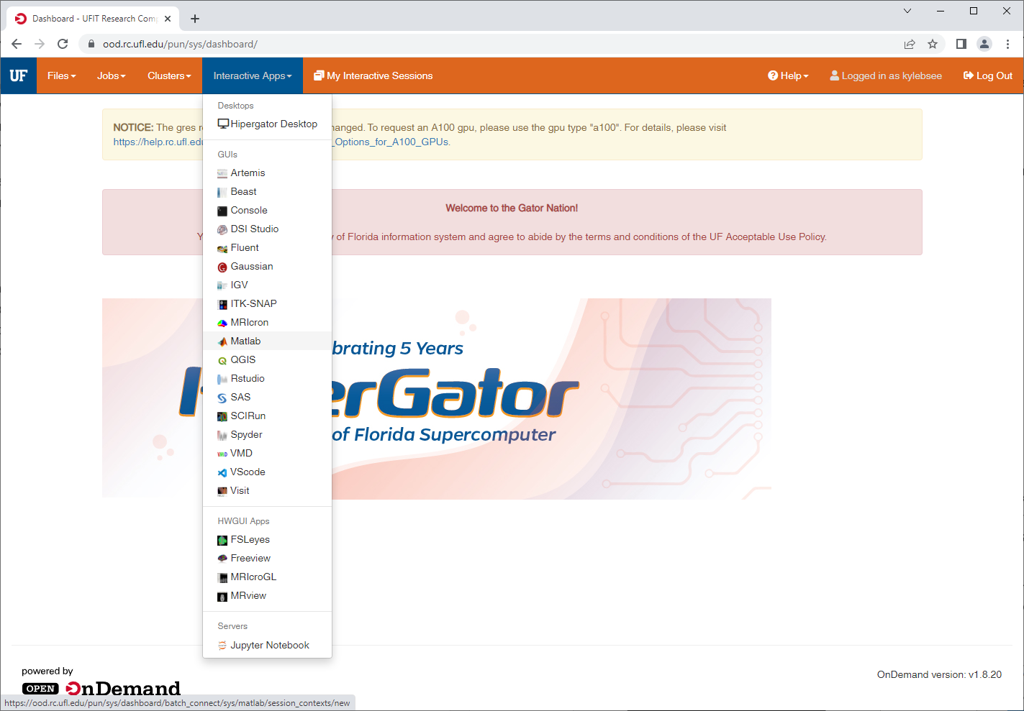
Navigate to Open OnDemand. Under Interactive Apps, select MATLAB.

Slide 6
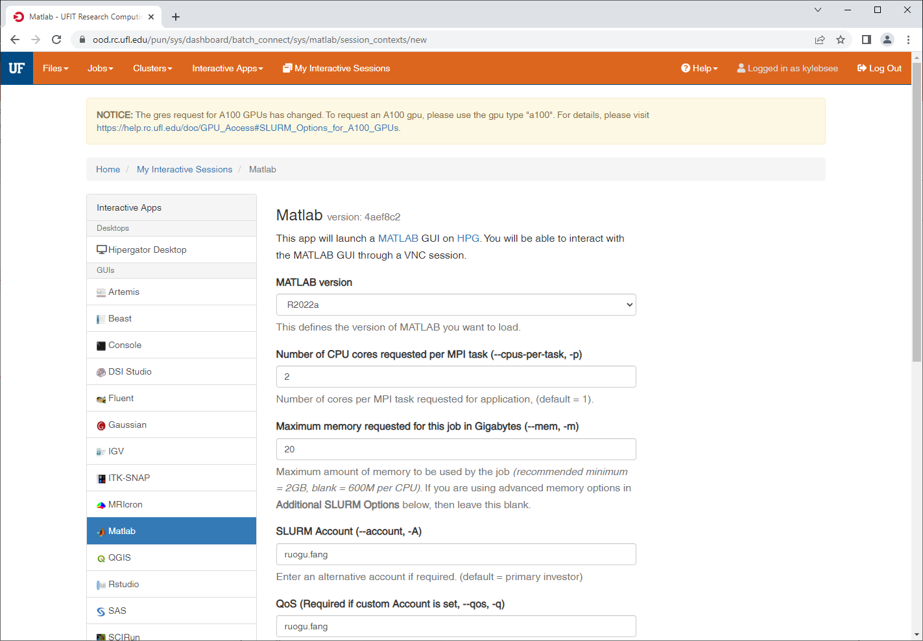
Change the following fields and launch MATLAB.
MATLAB version: R2022a
CPU cores: 2
Memory (GB): 20
Time requested: 12
Cluster partition: hpg-default
SLURM account: ruogu.fang
QoS: ruogu.fang

Slide 7
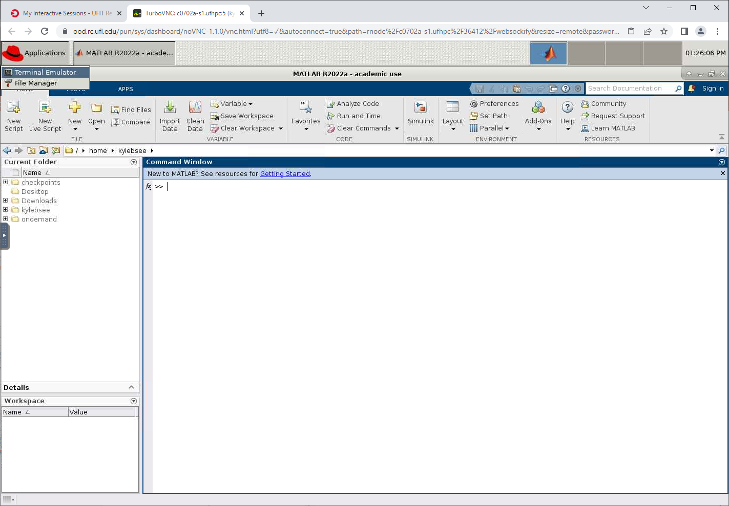
Open a Terminal Emulator found under the Red Hat Applications icon.

Slide 8
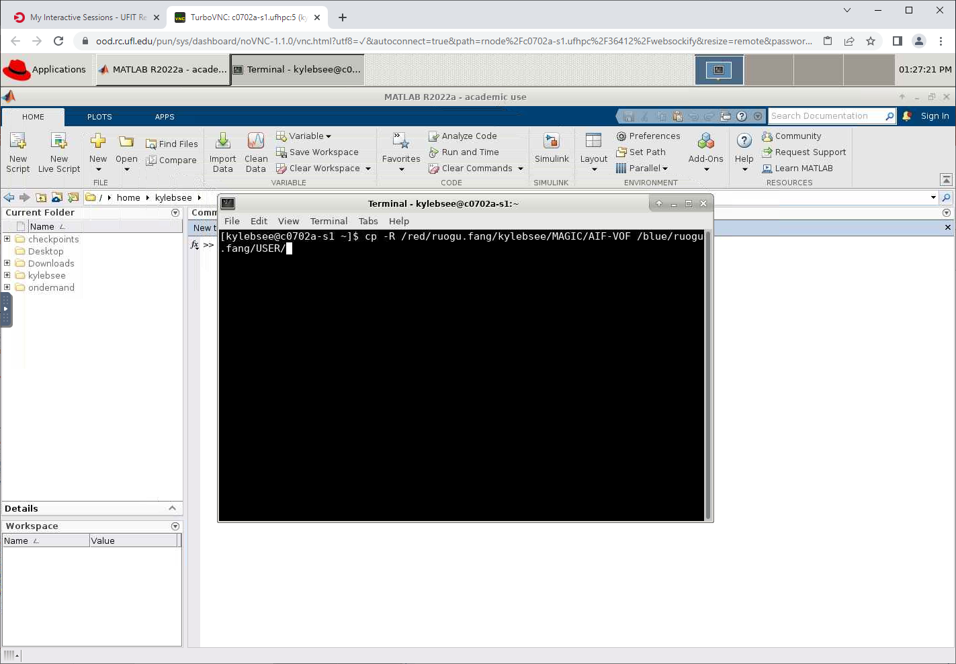
Run the command. Replace USER with your GatorLink. (There is a space between the red and blue addresses)
cp -R /red/ruogu.fang/kylebsee/MAGIC/AIF-VOF/ /blue/ruogu.fang/USER/

Slide 9
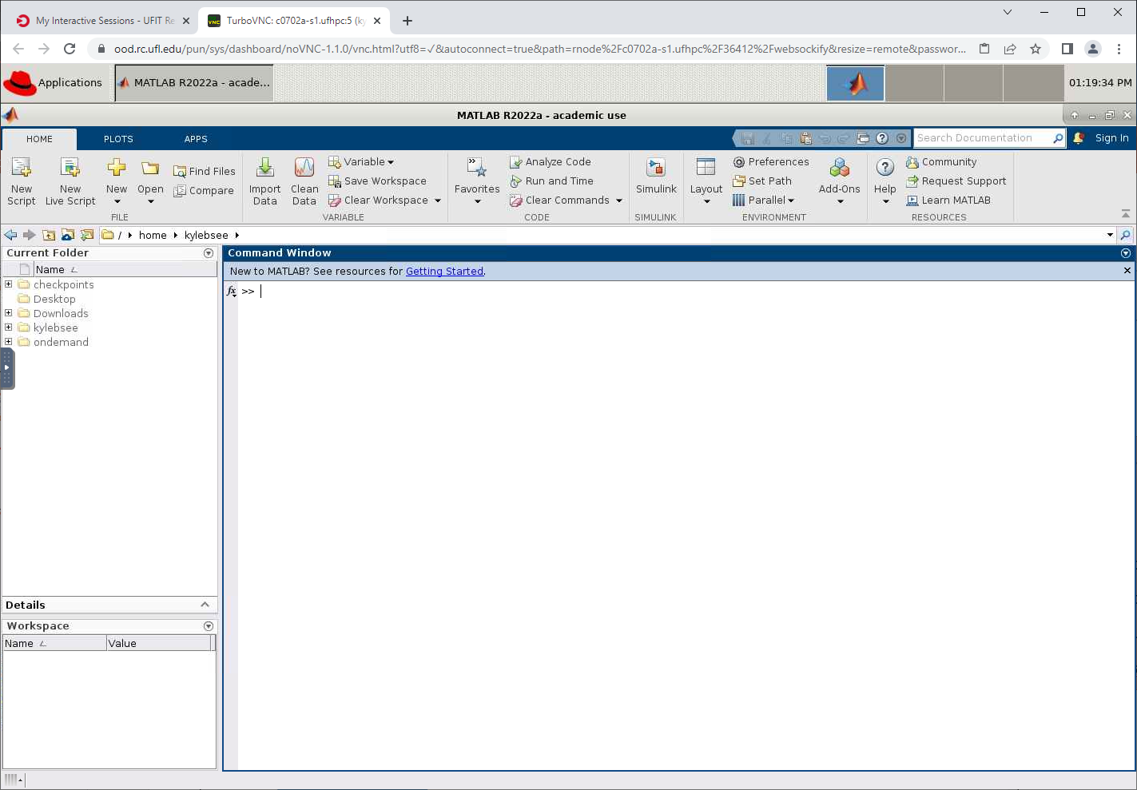
These are a few of MATLAB’s features.
Address bar
Current Folder
Command
Window
Workspace

Slide 10
Change the address to your folder.
/blue/ruogu.fang/USER/AIF-VOF

Slide 11
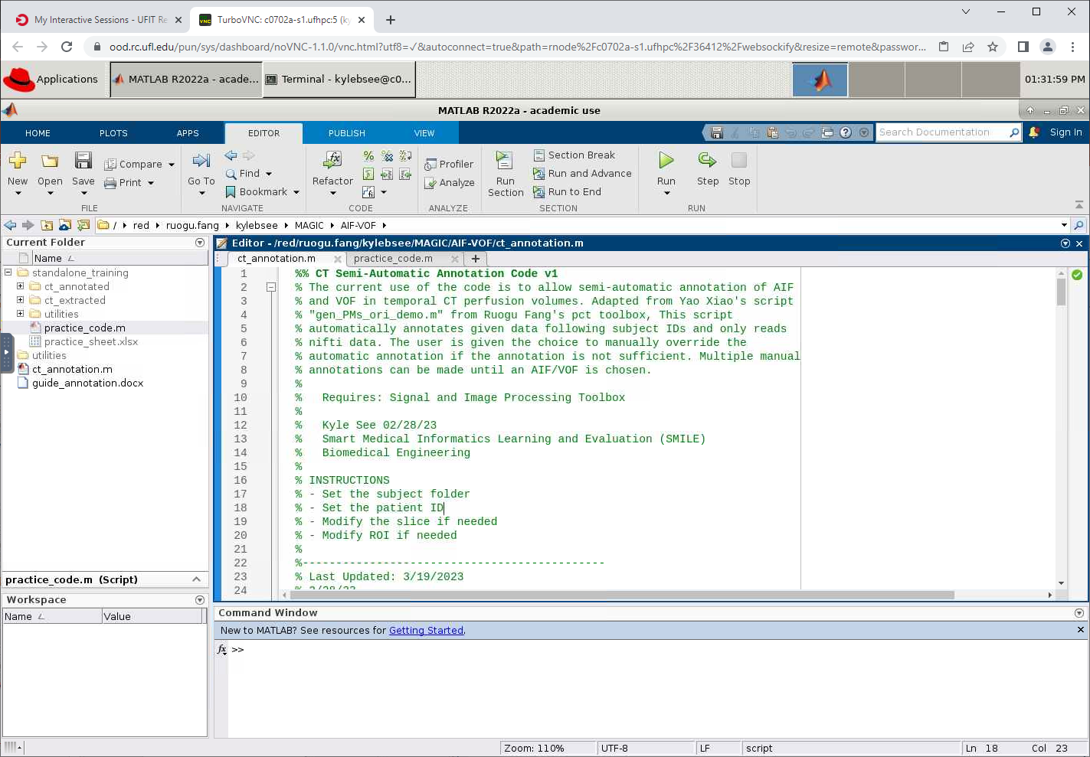
Open ct_annotation.m and practice_code.m

Slide 12
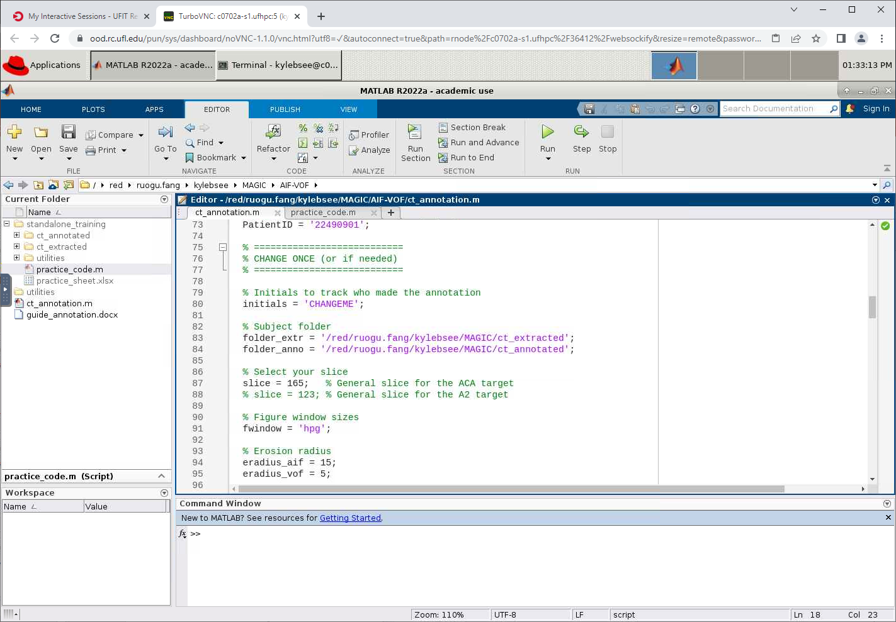
Change the initials variable to your initials in both files.

Slide 13
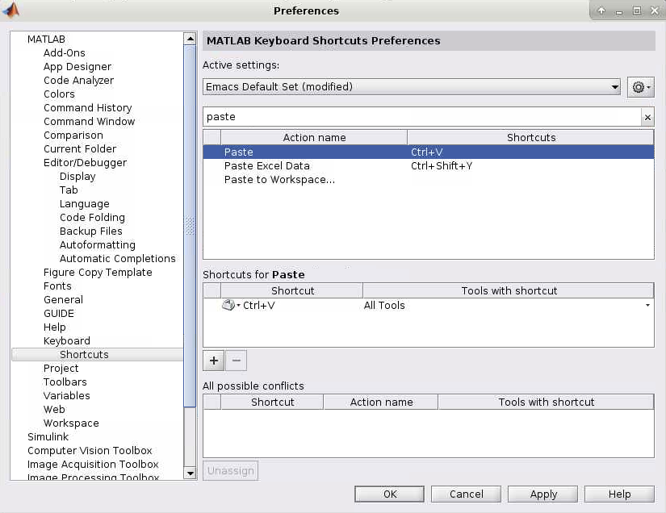
EXTRA: Adjust shortcut settings in MATLAB using the Preferences window.

Slide 14
Section 2: Standalone Training
This is not included since it is the exact same as section 3 but without automatic annotations.

Slide 15
Section 3: Annotating CTP

Slide 16
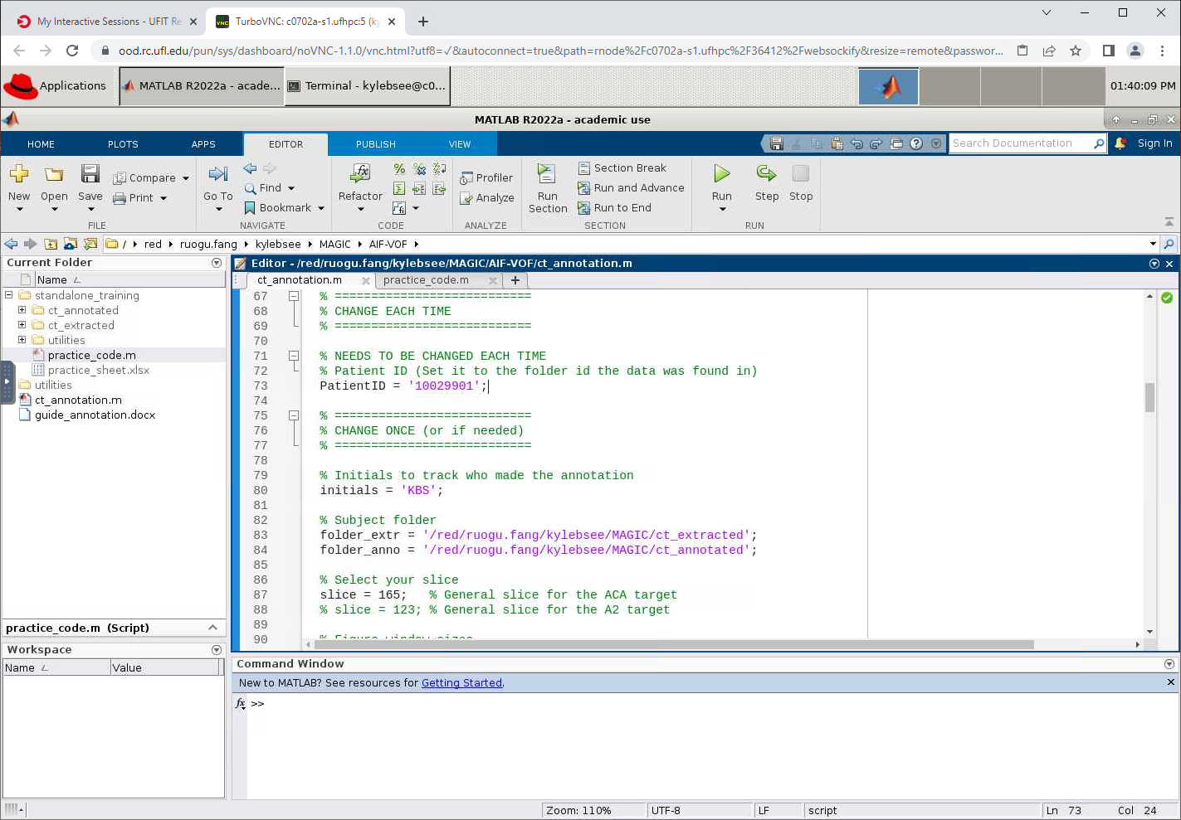
Change the subject ID and run the code.

Slide 17
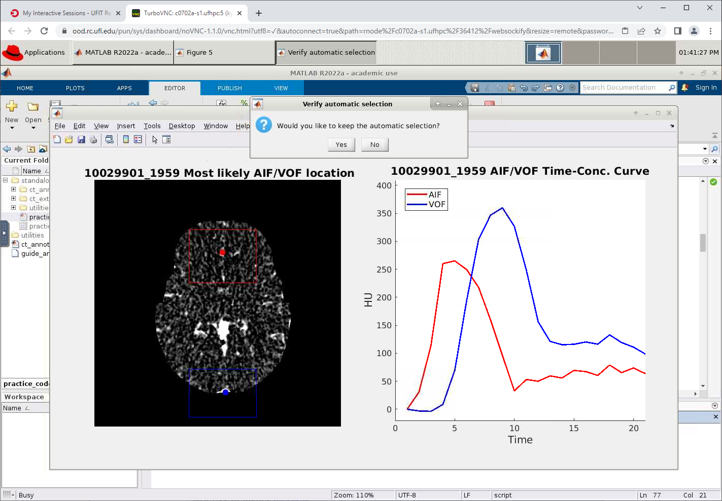
Accept or reject the automatic selection.

Slide 18
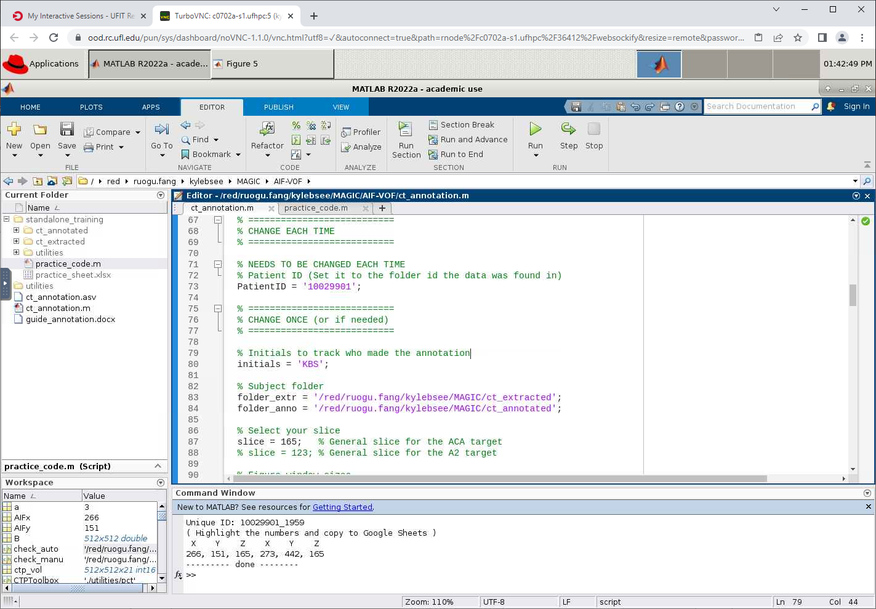
If accepted, highlight and copy the coordinates to the Google Sheet under the proper ID.

Slide 19
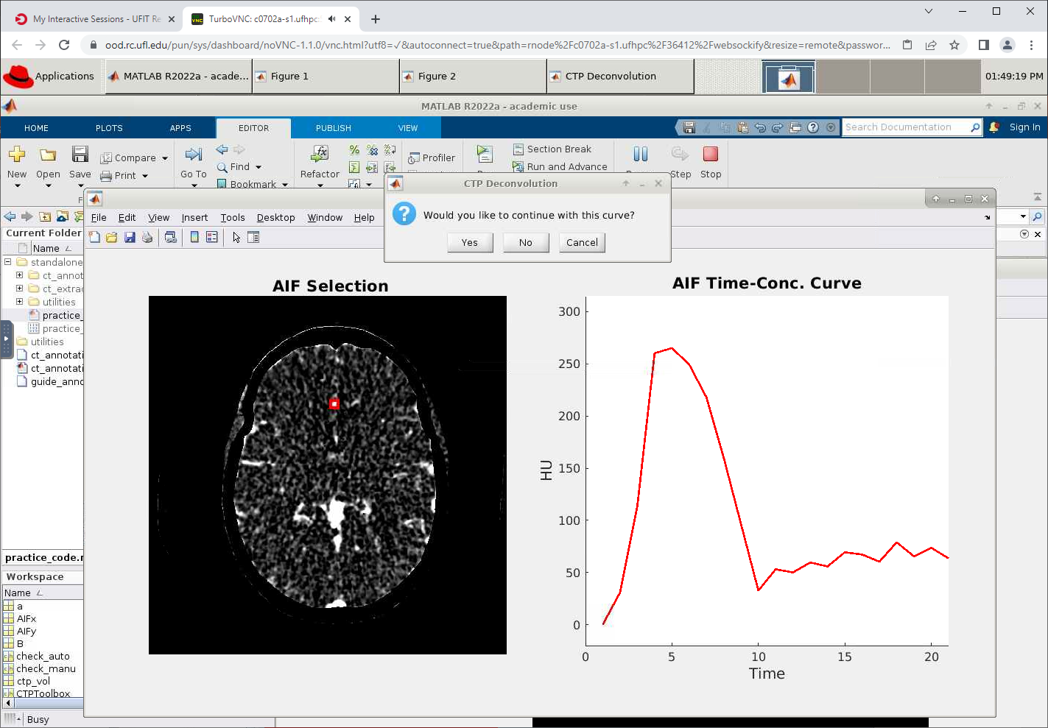
If rejected, select the artery and accept or reject the AIF.

Slide 20
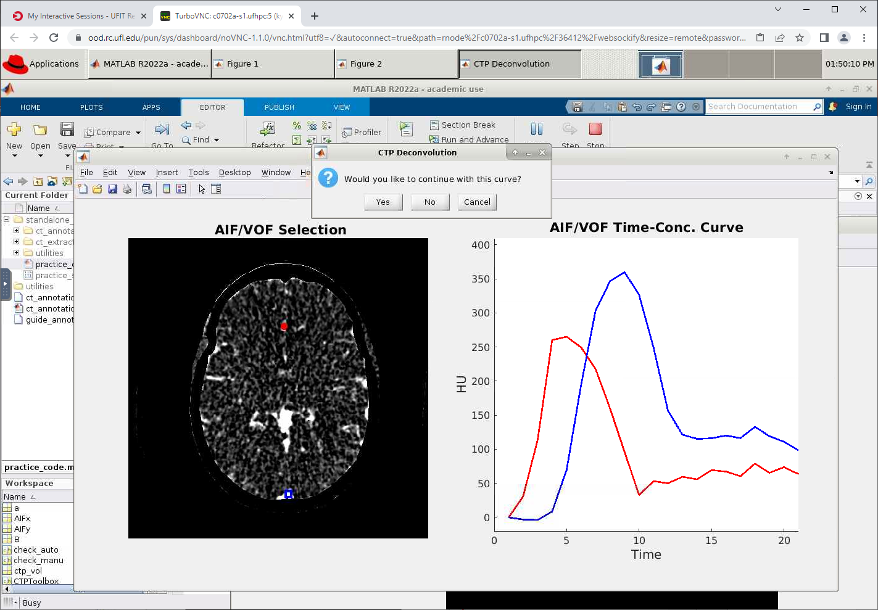
Select the vein and accept or reject the VOF.

Slide 21
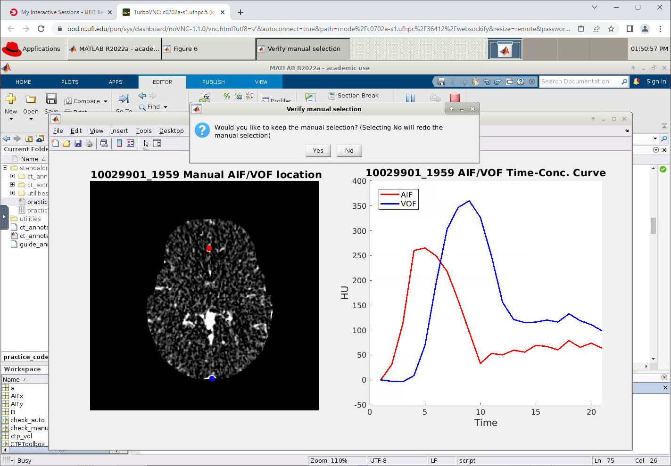
Confirm or redo your manual selection.

Slide 22
Highlight and copy the coordinates to your clipboard. Make sure you note the ID.

Slide 23
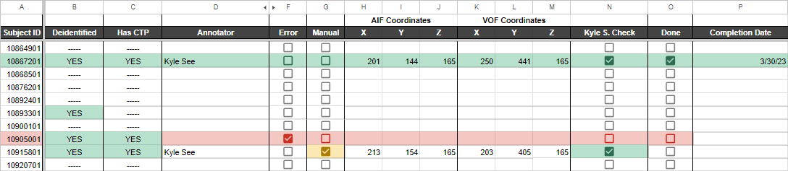
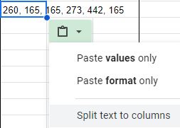
Fill in the Annotator, Error (if needed), Manual (if needed), and AIF/VOF Coordinates
If you paste the coordinate line, there is an option to “Split text to columns”.

Slide 24
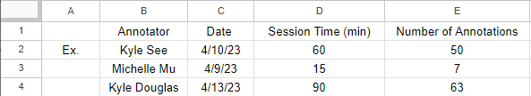
Record annotation session on the Sessions sheet.
If you forget to time, give your best estimate.

